Slide 1
Module 3: Digital Systems

Slide 2


2. Logic gates

Slide 3



logic gates – Symbols & Truth Table
In this section, we consider circuits called logic gates that combine several logic variable inputs to produce a logic-variable output.
AND Gate
OR Gate
NOT Gate
NAND Gate
NOR Gate
XOR Gate

Slide 4
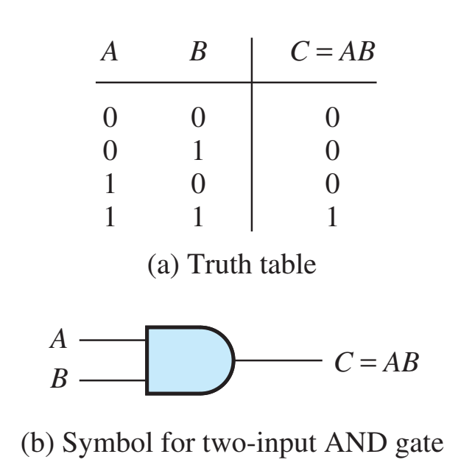



AND Gate
The AND operation on two logic variables, A and B, is represented as AB, read as “A and B.”
The AND operation is also called logical multiplication.

Slide 5
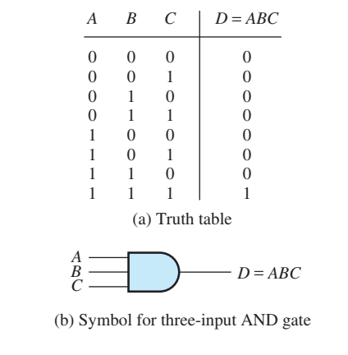





Three input and gate

Slide 6
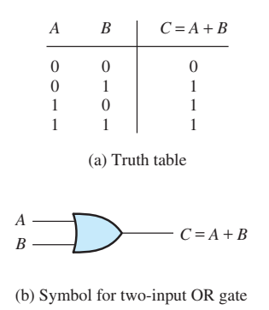






















Or gate
The OR operation of logic variables is written as A+B, which is read as “A or B.”
Notice that A+B is 1 if A or B (or both) are 1.
The OR operation is also called logical addition.

Slide 7
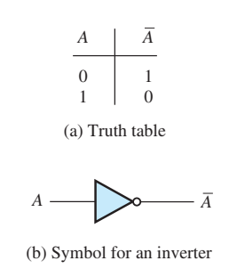



Not gate
The NOT operation on a logic variable is represented by placing a bar over the symbol for the logic variable. The symbol $\overline{A}$ is read as “not A” or as “A inverse.” If A is 0, $\overline{A}$ is 1, and vice versa.

Slide 8
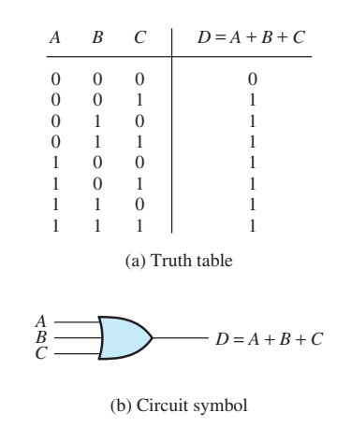
Three-input OR gate

Slide 9
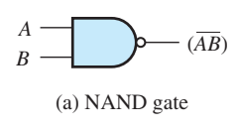












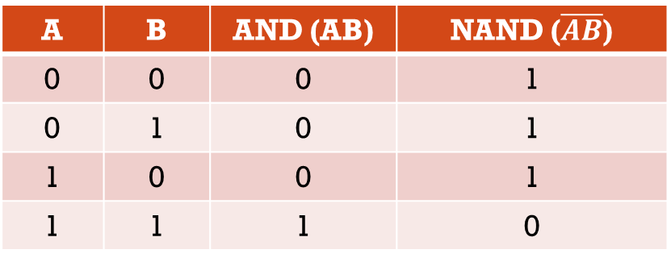











Nand gate
The NAND gate is equivalent to an AND gate followed by an inverter.
Notice that the symbol is the same as for an AND gate, with a bubble at the output terminal to indicate that the output has been inverted after the AND operation.
A | B | AND (AB) | NAND ($\overline{AB}$)
0 | 0 | 0 | 1
0 | 1 | 0 | 1
1 | 0 | 0 | 1
1 | 1 | 1 | 0

Slide 10
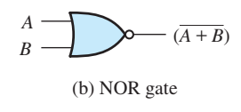

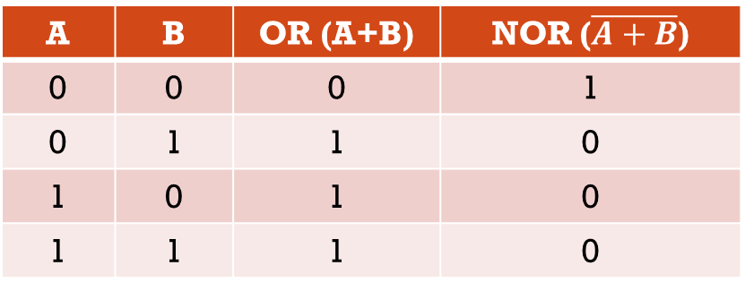


Nor gate
Similarly, the NOR gate is equivalent to an OR gate followed by an inverter.
A | B | OR (A+B) | NOR ($\overline{A+B}$)
0 | 0 | 0 | 1
0 | 1 | 1 | 0
1 | 0 | 1 | 0
1 | 1 | 1 | 0

Slide 11
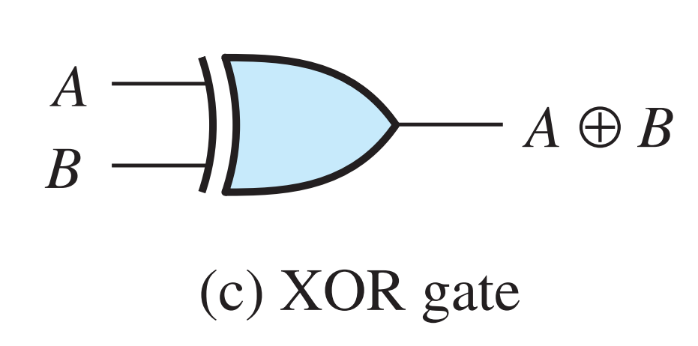

























Xor gate
A⊕B = A$\overline{B}$+$\overline{A}$B
The exclusive-OR (XOR) operation for two logic variables A and B is represented by A ⊕ B and is defined by
0 ⊕ 0 = 0
1 ⊕ 0 = 1
0 ⊕ 1 = 1
1 ⊕ 1 = 0
Notice that the XOR operation yields 1 if A is 1 or if B is 1, but yields 0 if both A and B are 1. The XOR operation is also known as modulo-two addition.
A | B | XOR
0 | 0 | 0
0 | 1 | 1
1 | 0 | 1
1 | 1 | 0

Slide 12
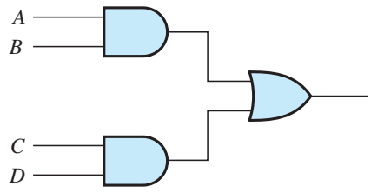
Example 1
Write a Boolean expression for the output of the logic circuit

Slide 13
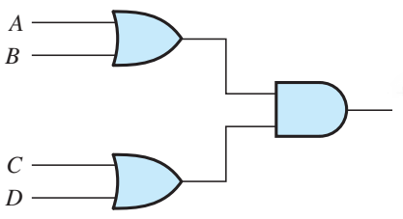
Example 2
Write a Boolean expression for the output of the logic circuit

Slide 14
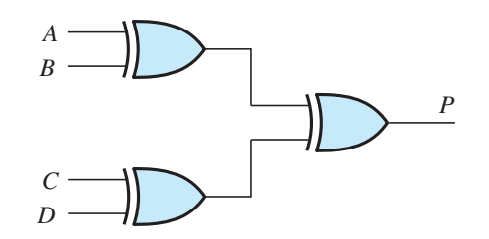
Example 3
Write a Boolean expression for the output of the logic circuit

Slide 15
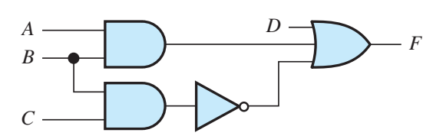
Example 4
Write a Boolean expression for the output of the logic circuit

Slide 16
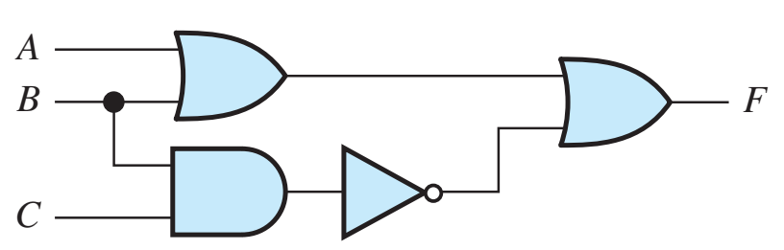
Example 5
Write a Boolean expression for the output of the logic circuit
Also give the truth table for the circuit

Slide 17
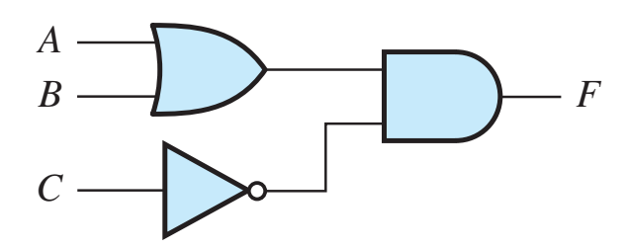
Example 6
Write a Boolean expression for the output of the logic circuit
Also give the truth table for the circuit

Slide 18
3. Boolean Algebra
Postulates and Theorems

Slide 19
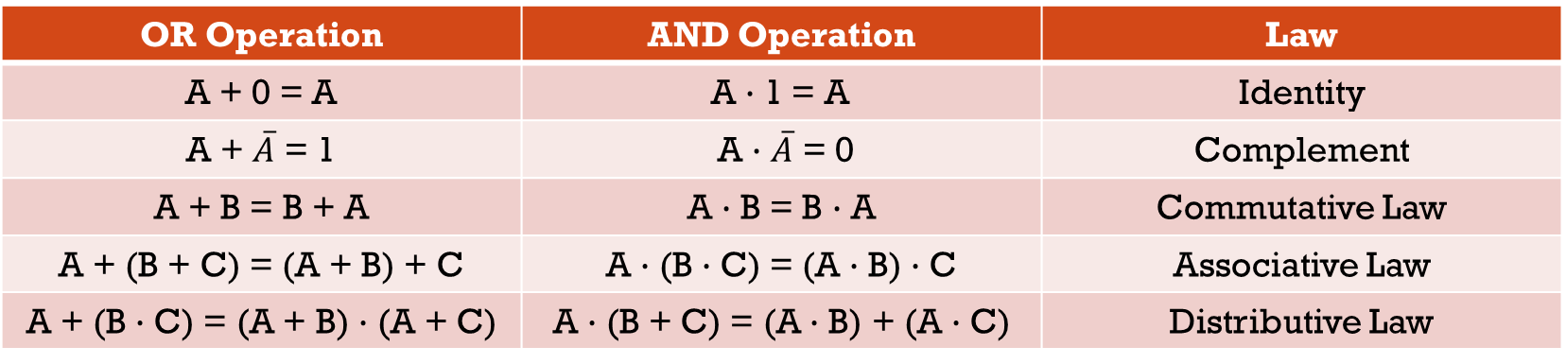






Postulates
Assume A, B, and C are logical states that can have the values 0 (false) and 1 (true).
"+" means OR, "·" means AND, and [$\overline{A}$] means NOT A.
OR Operation | AND Operation | Law
A + 0 = A | A · 1 = A | Identity
A + $\overline{A}$ = 1 | A · $\overline{A}$ = 0 | Complement
A + B = B + A | A · B = B · A | Commutative Law
A + (B + C) = (A + B) + C | A · (B · C) = (A · B) · C | Associative Law
A + (B · C) = (A + B) · (A + C) | A · (B + C) = (A · B) + (A · C) | Distributive Law

Slide 20

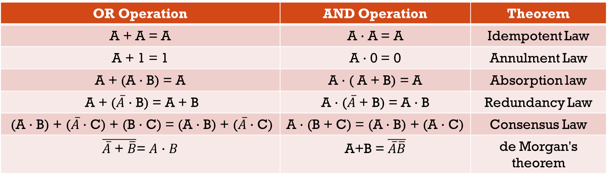



Theorems
OR Operation | AND Operation | Theorem
A + A = A | A · A = A | Idempotent Law
A + 1 = 1 | A · 0 = 0 | Annulment Law
A + (A · B) = A | A · ( A + B) = A | Absorption law
A + ($\overline{A}$ · B) = A + B | A · ($\overline{A}$ + B) = A · B | Redundancy Law
(A · B) + ($\overline{A}$ · C) + (B · C) = (A · B) + ($\overline{A}$ · C) | A · (B + C) = (A · B) + (A · C) | Consensus Law
$\overline{\overline{A}\text{ + }\overline{B}}$= $A$ · $B$ | A+B = $\overline{\overline{A}\overline{B}}$ | de Morgan's theorem

Slide 21

Using a Truth Table to Prove a Boolean Expression
Example 1: Prove the associative law for the OR operation , which states that
(A + B) + C = A + (B + C)
Example 2: Use truth tables to prove the following operations
A(BC) = (AB)C = ABC
A(B + C) = AB + AC
Example 3: Prepare a truth table for the logic expression
D = AB + C

Slide 22

MCQ 1
The expression for Absorption law is given by _________
a) A + AB = A
b) A + AB = B
c) AB + AA’ = A
d) A + B = B + A
A

Slide 23
MCQ 2
According to Boolean law: A + 1 = ?
a) 1
b) A
c) 0
d) A’
A

Slide 24
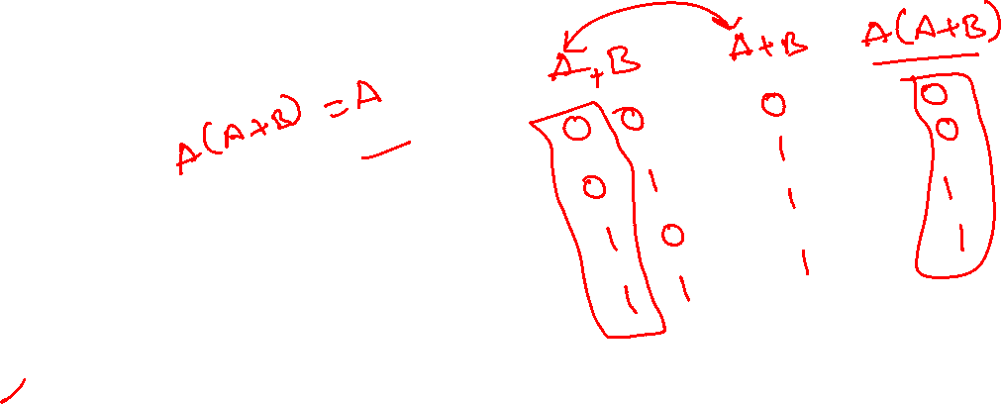
MCQ 3
A(A + B) = ?
a) AB
b) 1
c) (1 + AB)
d) A
D

Slide 25
MCQ 4
DeMorgan’s theorem states that _________
a) (AB)’ = A’ + B’
b) (A + B)’ = A’ * B
c) A’ + B’ = A’B’
d) (AB)’ = A’ + B
A

Slide 26
MCQ 5
The boolean function A + BC is a reduced form of ____________
a) AB + BC
b) (A + B)(A + C)
c) A’B + AB’C
d) (A + C)B
B

Slide 27
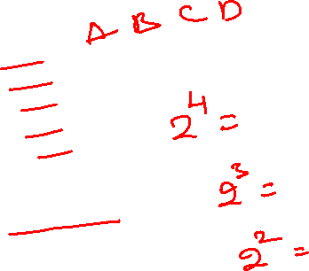
MCQ 6
How many truth table entries are necessary for a four-input circuit?
a) 4
b) 8
c) 12
d) 16
D

Slide 28

MCQ 7
Which input values will cause an AND logic gate to produce a HIGH output?
a) At least one input is HIGH
b) At least one input is LOW
c) All inputs are HIGH
d) All inputs are LOW
C

Slide 29

MCQ 8
The basic logic gate whose output is the complement of the input is the ___________
a) OR gate
b) AND gate
c) INVERTER gate
d) XOR gate
C

Slide 30

MCQ 9
In Boolean algebra, the OR operation is performed by which properties?
a) Associative properties
b) Commutative properties
c) Distributive properties
d) All of the Mentioned
D

Slide 31

MCQ 10
In which of the following gates the output is 1 if and only if at least one input is 1?
a) AND
b) NOR
c) NAND
d) OR
D

